Slide 1
5.3 Exercises
Ori Rinaman
Bellevue University

Slide 2
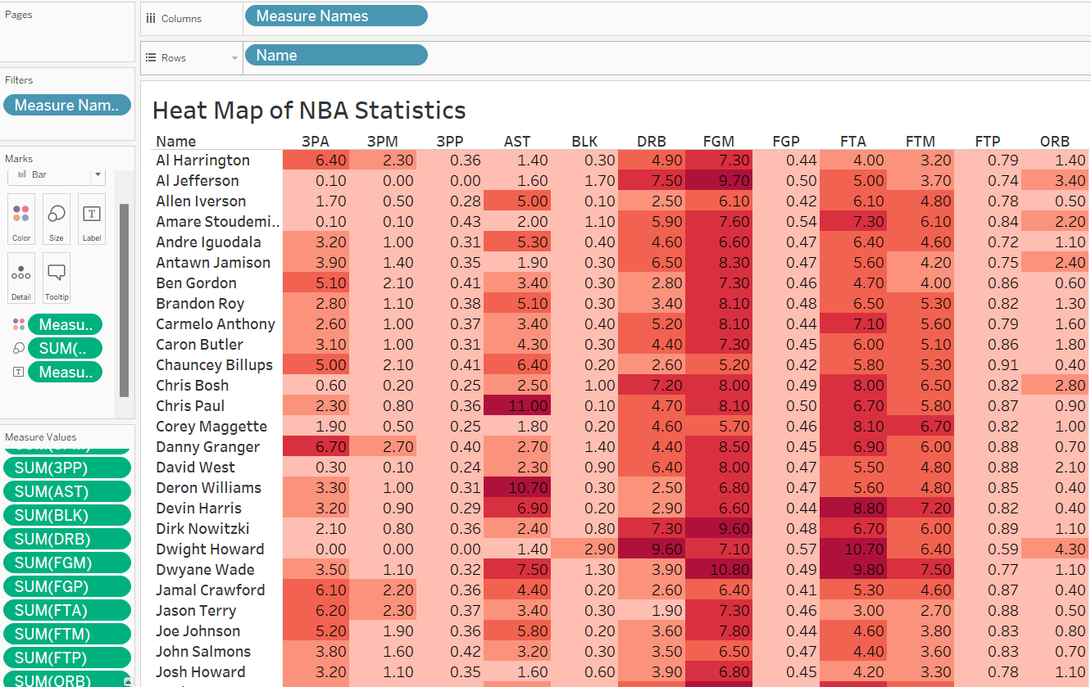
Heat Map (Tableau)

Slide 3
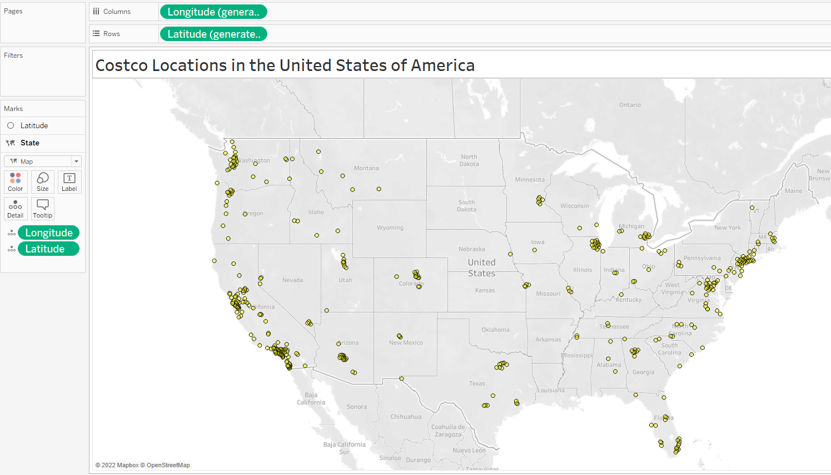
Spatial Chart (Tableau)

Slide 4
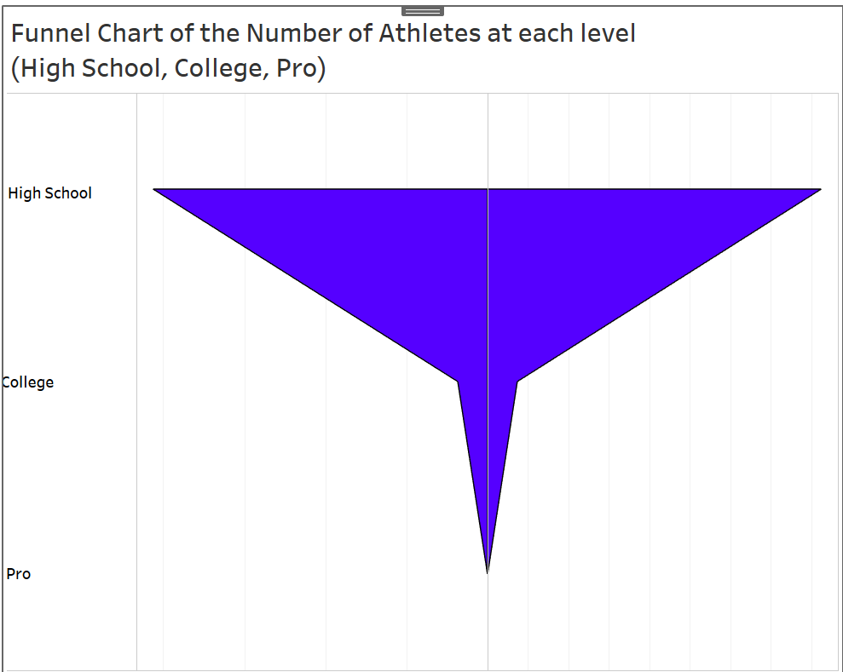
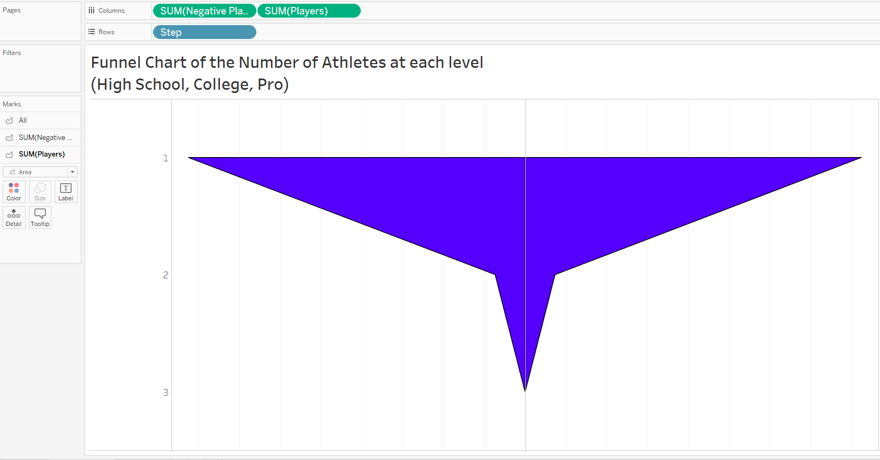
Funnel/Violin Chart (Tableau)

Slide 5
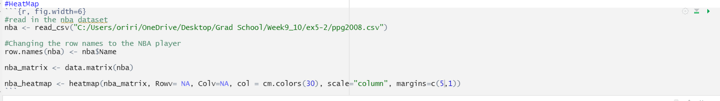
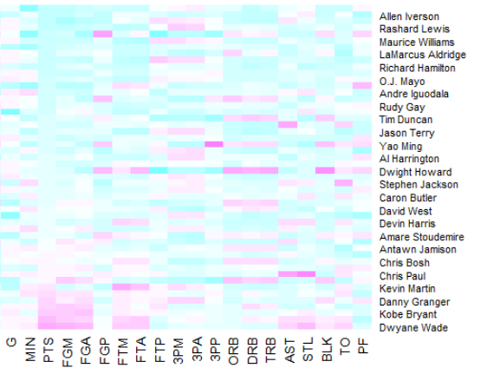
Heat Map (R)

Slide 6
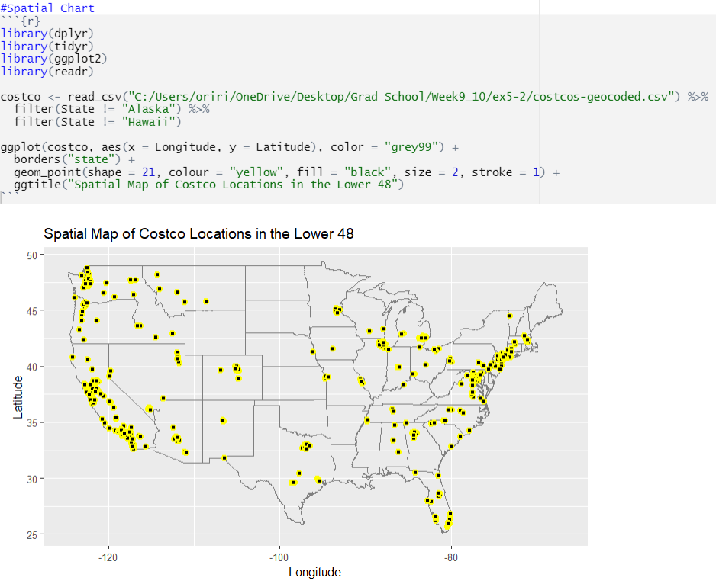
Spatial Chart (R)

Slide 7
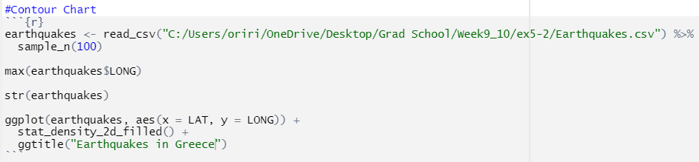
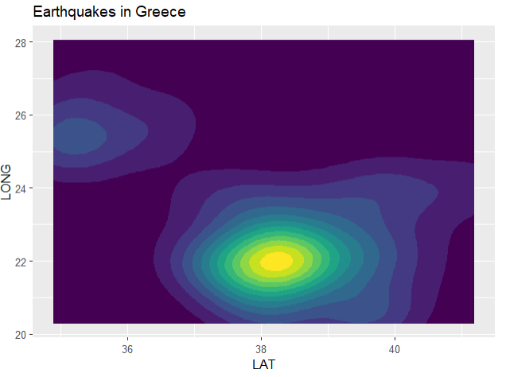
Contour Chart (R)

